Slide 1
Blue River Metropolitan District (BVMD)
River Committee
River Access Survey: Usage & Feedback
Survey data was collected in June 2023 from residents who are fishing pass holders who also purchased their properties within the past 3 years (2020-2023). Survey response rate was 59% (13/22).

Slide 2
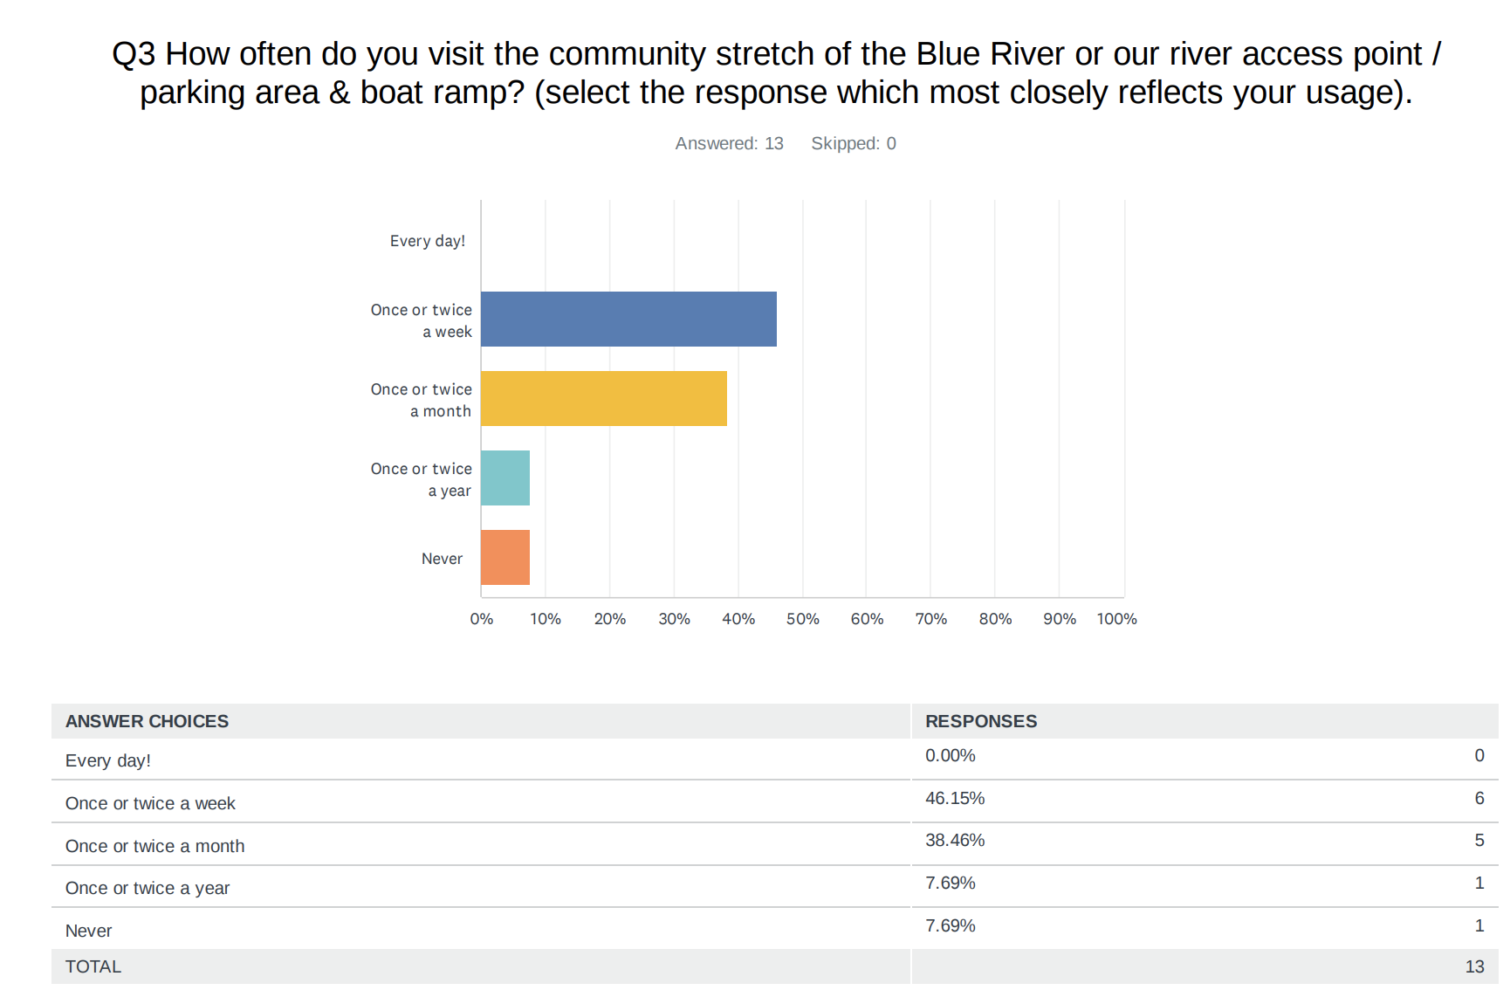

Slide 3
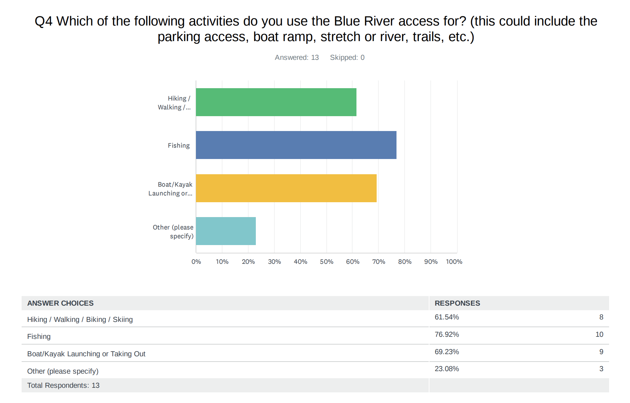
Specific comments related to the “other” category:
“we r avid rafters but have not used the launch mainly bc we have a bigger boat and can't trailer easily , also i've not been able to find info about the gate code easily being new to the area”
“I desperately want to use my access but don't know how. I know where to park but not where I am aloud. I have had a pass and a license since I moved here, but can't get the information I need. I have asked people to show me, give me map and no help has been provided. I am upset that I haven't been able to use this benefit.”
“Picnic lunch.”

Slide 4
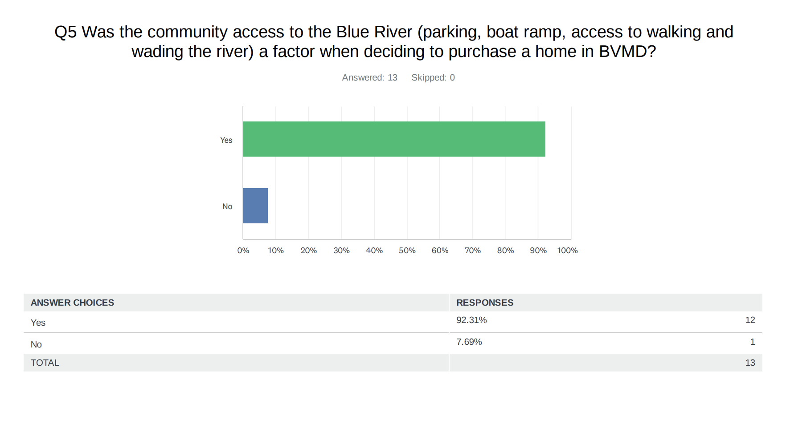

Slide 5
Q6 If your response to question 5 was "Yes" please provide a brief comment on why you value the community access to the Blue River.
It is obviously a huge reason we bought here. We bought for private access and would prefer minimal public access
Not a lot of communities with access to rivers in CO. Day floats with family and private fishing access. This makes our community more valuable and desirable.
The ONLY reason I purchased in this neighborhood and plan to build a house is because of the boat launch access.
It was not the final factor, nor extremely important. However, it does make for an added treat.
The boat ramp and private access to the BVMD community water was the primary factor in purchasing my home in this neighborhood. I had also entertained the idea of purchasing a vacant plot for immediate access rights before my current home became available for sale. The BVMD access is a one-of-a-kind resource even when considering other private water access in adjacent counties.

Slide 6
Q6 If your response to question 5 was "Yes" please provide a brief comment on why you value the community access to the Blue River continued…
Having access to the Blue is something special - from fishing to boating to letting our dogs play - we're grateful for our access.
I think it's great to have water access and I'm hoping to use it more now that my boys are getting bigger. Teach them to fish and go rafting with friends more.
The private fishing access and not having tons of people around.
The river access was what led me to focus solely on purchasing in our neighborhood. I would not be here if it weren't for the river.
My dog needs water when out and I enjoy the tranquility of being on/ at the water.
It's sounds great. I just wish someone would give me the directions and rules so I could use it.

